Slide 1
International Limited, Telford
DSEAR Webinar Thursday 27th January 2022

Slide 2
Rebecca Crosland SHEP Chair (Head of Health & Safety at BESA)

Slide 3
So what is / who is, SHEP?
For too long, the HSE has been regarded as a form of police force; an enforcement agency actively seeking out those failing to meet the latest set of H&S regulations

Slide 4
So what is / who is, SHEP?
In reality, the last thing that the HSE wish to do, is prosecute organisations and individuals with whom they could have engaged long before the situation reached litigation.
The HSE is about protecting lives and improving our working environment. Indeed, this mission is manifest in their strategy document; “Helping GB Work-well.”

Slide 5
So what is / who is, SHEP?
HSE cannot achieve this objective alone. It requires the co-operation and support of the whole of British industry. It requires an on-going dialogue between the two parties; a partnership; hence the creation of the Safety & Health in Engineering Partnership or “SHEP”

Slide 6
Purpose of Today’s webinar?
The Dangerous Substances and Explosive Atmospheres Regulations 2002 (DSEAR) require employers to control the risks to safety from fire, explosions and substances corrosive to metals.
This webinar is designed to provide attendees with practical information to ensure employers understand their legal obligations and the potential limitations of relying on conformity assessments.
This weminar will improve your ability to manage risks that need controlling under DSEAR. It is aimed at health and safety managers, factory managers and engineers in engineering SMEs.

Slide 7
AGENDA
Peter Slee-Smith
DSEAR Business Manager at Dodman Ltd
Scott Harding
Sales Director at Woodcock & Wilson
Q&A Session
Questions to be placed in the Question box please!

Slide 10
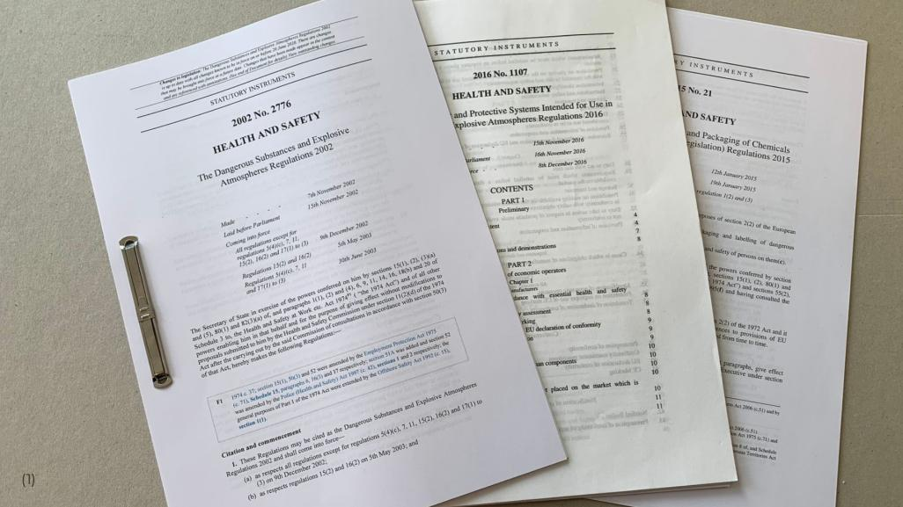
Notes:
(1) Reading regulations can be dry, and sometimes it is easier to listen to a story about real people and their experiences. This story is true, although the characters' names have been changed. This story follows an engineer's journey as she attempts to understand then implement DSEAR compliance for the first time.

Slide 11
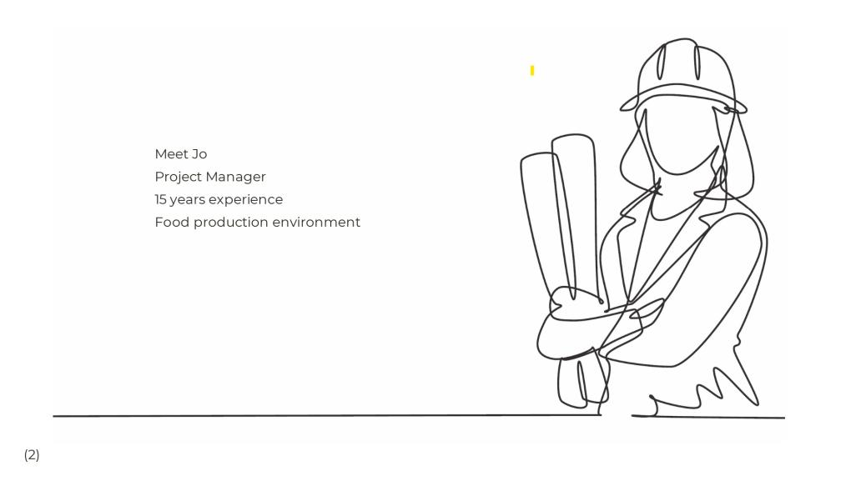
Notes:
(2) Let me introduce the hero of our story. Jo is a project manager who works for a large cereal processing company. Jo is experienced and has been responsible for integrating many large and complex projects over more than fifteen years. Jo is one of the more senior members of the project team and is very familiar with the food processing systems used by the company.

Slide 12
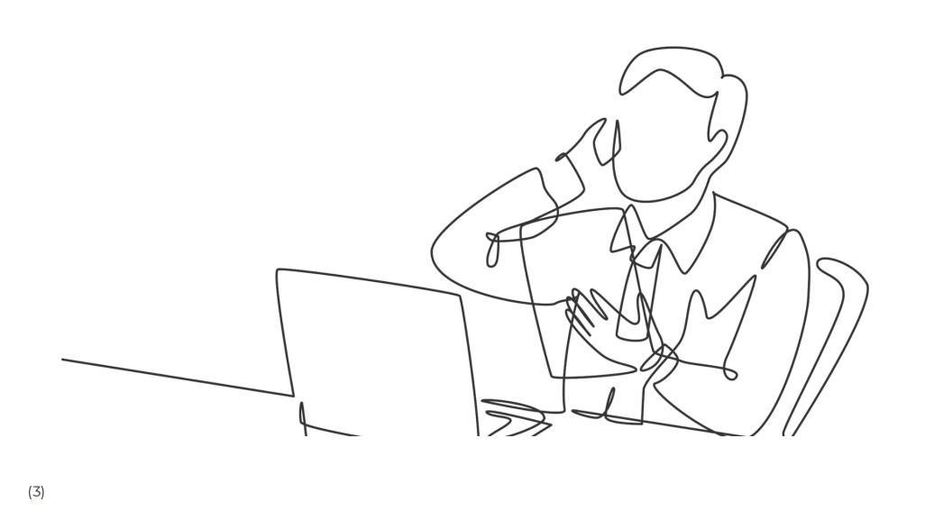
Notes:
(3) The company's insurance providers have asked the company to conduct a DSEAR audit to determine the risk of fire and explosion from storing, handling, and processing dangerous substances. The company engages a specialist auditor to carry out a blanket audit across the complete factory. The report highlights more than a thousand actions. Some of these actions have a high priority. Jo is initially flattered by the responsibility for managing such a large project.

Slide 13
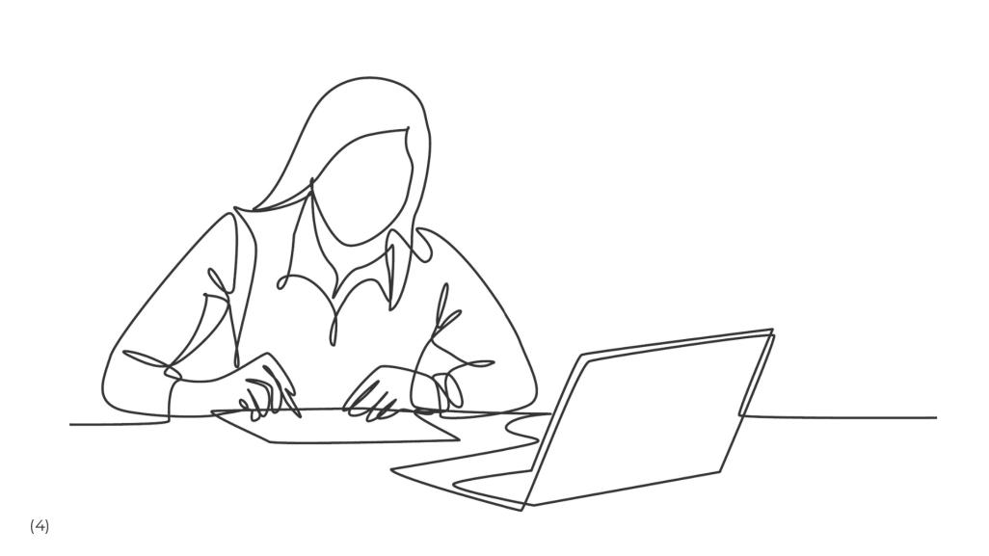
Notes:
(4) Jo sits down with the DSEAR audit at her desk, somewhat surprised by the number of actions identified by the report. Jo was previously confident that while some of the process systems used to manufacture cereals were old, maintenance was good, and there was no history of dust explosions. There were, on occasions, localised fires, but this was an old factory and to be expected. Jo has come across DSEAR but never really taken the time to understand the regulations entirely. Jo understood that DSEAR was referred to by the Health and Safety at Work Act but thought that as long as suppliers considered ATEX in the design of new equipment, this would automatically cover the requirements of DSEAR.

Slide 14
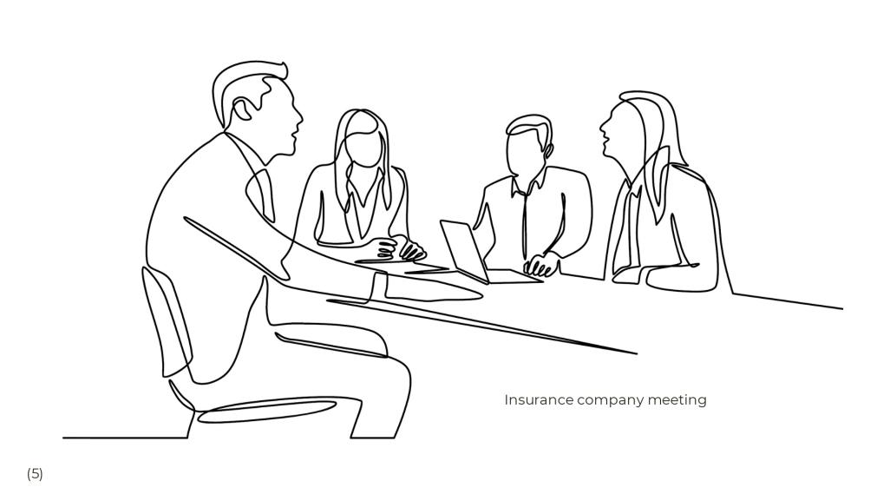
Notes:
(5) The insurance company scheduled a meeting with Jo to discuss the implementation plan to resolve the outstanding DSEAR issues. The insurance company requested timescales. Initially, the insurance company was helpful and patient but informed Jo that the identified risks would eventually require an adjustment of the business continuity premiums. There was no budget yet allocated, and Senior management had yet to understand the high cost for DSEAR compliance. With so little understanding of the implications that DSEAR would have, it increases the pressure on Jo.

Slide 15
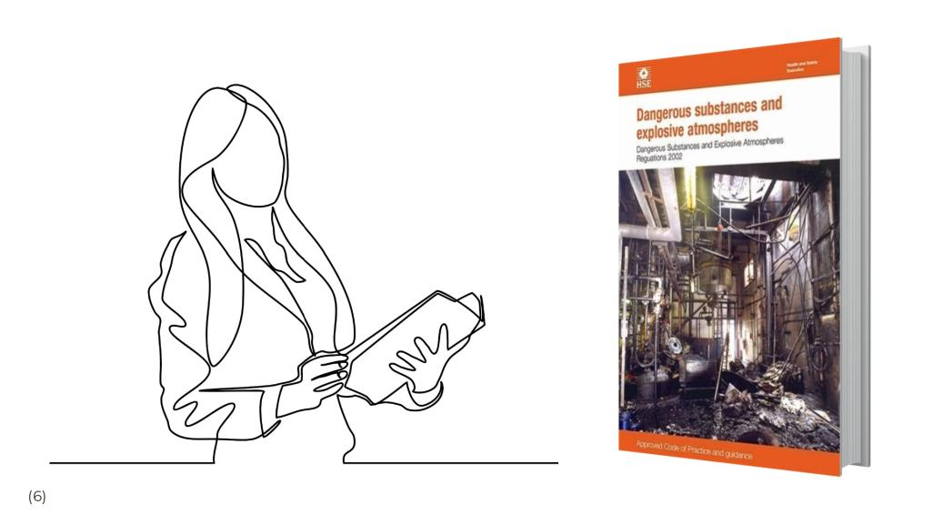
Notes:
(6) Jo downloaded the DSEAR Approved Code of Practice (ACOP L138); the document offers a little more clarity, but reading the paper is still difficult to find practical guidance. Jo starts to read the document.

Slide 16
Notes:
(7) Regulation 1 explains that DSEAR came into force in 2002 when it became a requirement of UK law.

Slide 17
Notes:
(8) Regulation 2 defines the terms used by DSEAR. It explains that dangerous substances could, if not adequately controlled, cause harm to people due to fire or explosion, asphyxiation or corrosion of metal. Jo understands that this includes virtually every material handled within the factory.

Slide 18
Notes:
(9) Regulation 3 details the types of activities where DSEAR does not apply. Unfortunately for Jo, food production is not one of these.

Slide 19
Notes:
(10) Regulation 4 explains that it is the Employer that is responsible for DSEAR. Any thoughts that Jo could delegate the responsibility for DSEAR to her suppliers quickly evaporates. The responsibility for DSEAR remained with the company and, therefore, with her. Failure to comply may end in prosecution. It isn't until Jo starts looking at the following regulation that Jo realises the enormity of the task facing her.

Slide 20
Notes:
(11) Regulation 5 requires that Jo carries out a detailed risk assessment.

Slide 21
Notes:
(12) It will be necessary to find out the hazardous properties of each substance handled, but this requires far more information than is usually provided in the MSDS (Material Safety Data Sheets) offered by the material suppliers. It may be necessary to complete specialist tests to determine explosivity parameters, to understand the sensitivity to ignition sources, dangerous concentration levels, temperatures that could ignite the material and the magnitude of an explosion, should it occur. Collecting this data is a big task for a diverse manufacturing company with many ingredients.

Slide 22
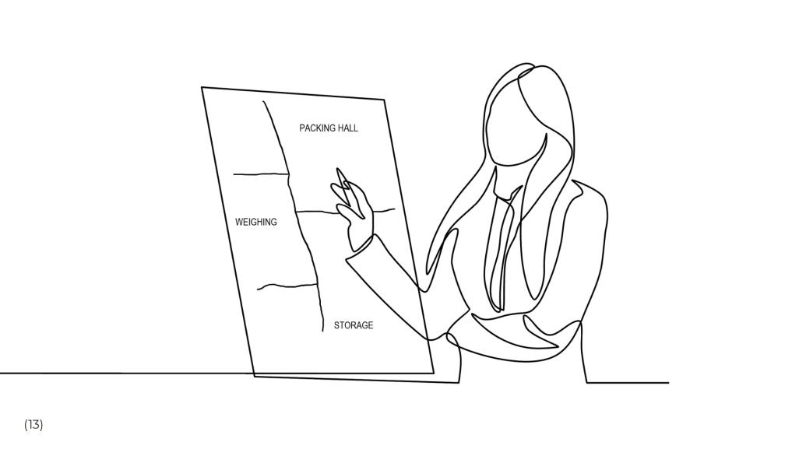
Notes:
(13) With the knowledge of each dangerous substance, Regulation 5 further requires identifying the plant areas where the hazard will or may occur. How much material is involved? What happens if the material mixes with other materials? How does the material change when handled or processed? What could happen if there was a failure? What could create an explosive atmosphere? How long could an explosive atmosphere persist?

Slide 23
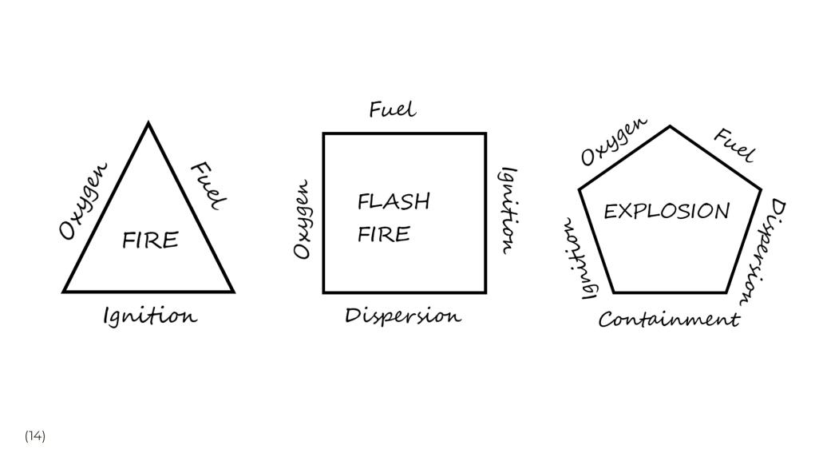
Notes:
(14) Jo understands that there needs to be fuel, oxygen, and an ignition source for a fire to occur. She also knows that dispersion of fine particles can cause a flash fire, and a flash fire can quickly become an explosion if it takes place in a confined space.

Slide 24
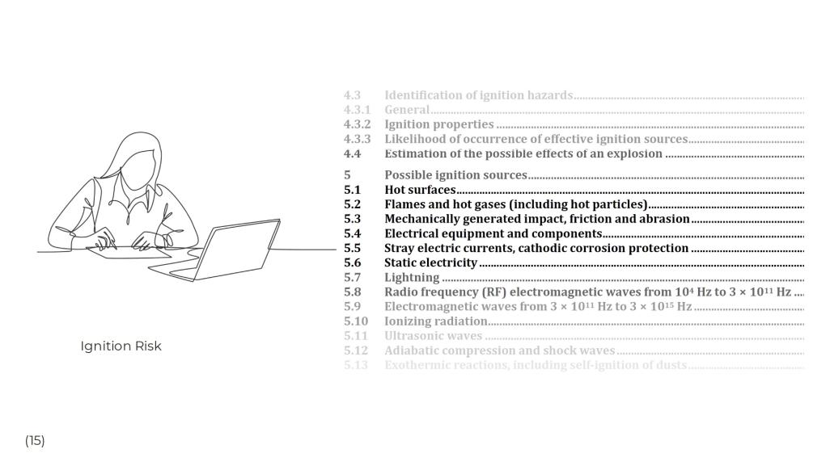
Notes:
(15) Regulation 5 requires a detailed ignition risk assessment. Preparing an ignition risk assessment requires a thorough understanding of each process and the equipment used within that process. It is essential to consider all ignition sources, including hot surfaces, impact sparks, electrical faults, static electricity and many others. All equipment states must be considered, including normal operation, maintenance, and failure modes.

Slide 25
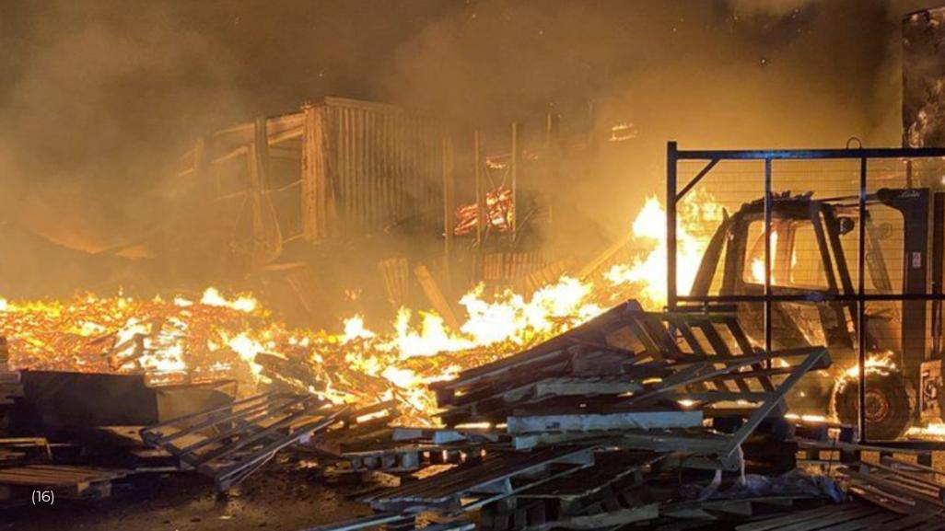
Notes:
(16) Reading Regulation 5 further, Jo finds out that she is also required to consider the scale of the fire or explosion that may occur. She needs to consider how the explosion could propagate between areas through openings or ducts.

Slide 26
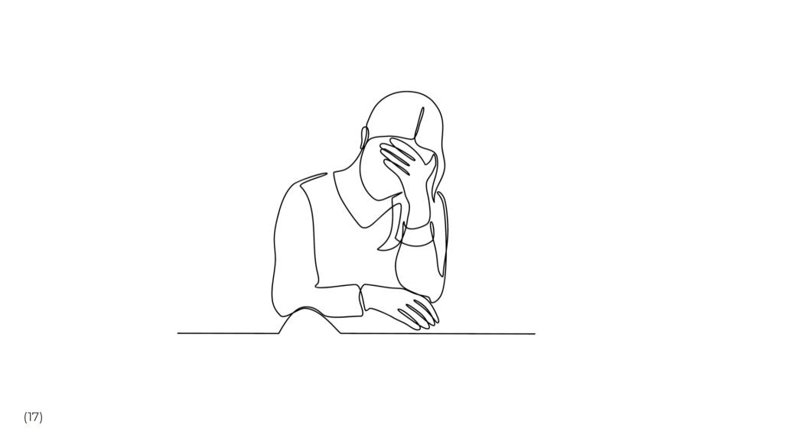
Notes:
(17) The DSEAR audit Jo has received provides a basic risk assessment, although this will require considerable additional detail before any design can commence. Jo realises that the risk assessment is just the start of the process. So far, there are no solutions, and there has been no reduction of risk.

Slide 27
Notes:
(18) Jo starts to read Regulation 6, which commences with the statement that it is the Employer's responsibility to ensure each risk is eliminated or reduced as far as reasonably practical. But what does "as far as reasonably practical" mean? Jo finds a document published by the Health and Safety Executive which explains that "as far as reasonably practical" will only ever be established in a court of law. The website provides examples for extreme cases, but the subjective requirement only fuels Jo's concern.

Slide 28
Notes:
(19) It is clear from reading Regulation 6 that there is an expectation on Jo to redesign the process to substitute the material or change the operation to eliminate the risk. Jo is concerned about how a proposal would be received from her colleagues when she suggests changing the ingredients or the manufacturing process to reduce risk. Changing the process is not an option.

Slide 29
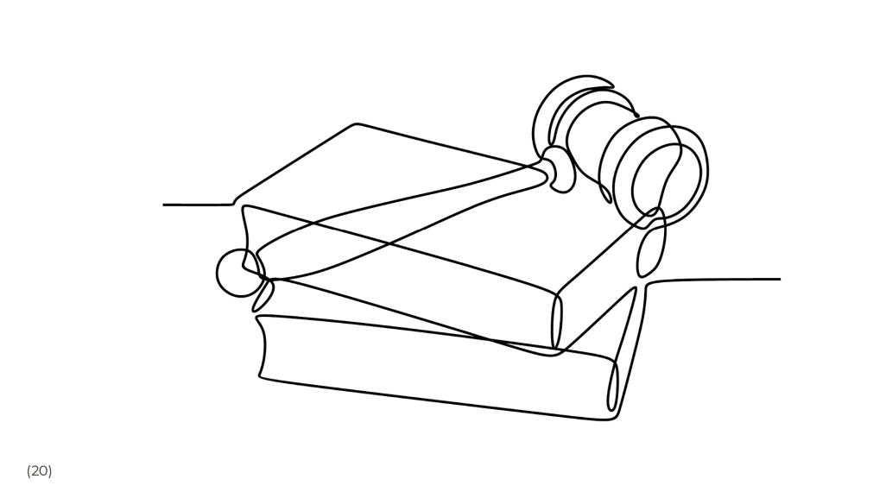
Notes:
(20) Regulation 6 also requires that if it is not possible to eliminate the risk, the Employer shall as far as reasonably practical control the risks and reduce the harmful effects of a fire or explosion. Again this term of what is reasonably practical leaves Jo feeling exposed. What is the acceptable cost to avoid death or injury? Would a court take the same view as her colleagues in Finance?

Slide 30
Notes:
(21) Jo reads that controlling the risk of fire or explosion requires a six-stage set of measures to be applied in order of priority. • Reduce the quantity of the dangerous substance • Avoid or reduce the release of the substance. • Prevent the formation of an explosive atmosphere, perhaps using ventilation. • Safely collect and remove the dangerous substance. • Avoid any ignition sources or create any adverse conditions. • Segregate harmful substances

Slide 31
Notes:
(22) Regulation 6 requires Jo to reduce the harm caused by a fire or explosion using six further measures. • Reduce the number of people exposed • Avoid the propagation of fires or explosions • Provide explosion relief • Provide explosion suppression • Design equipment to withstand the pressure of an explosion • Provide personal protective equipment (PPE) In addition, it will be necessary to design, construct and maintain the workplace to reduce risk. Ensure power and control systems are safe and that training and instruction are adequate, and a permit to work system is employed.

Slide 32
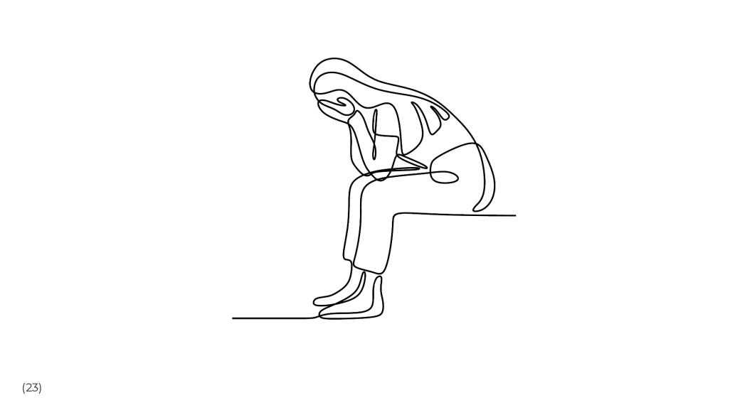
Notes:
(23) Jo now realises the full extent of the work she has to achieve. Understanding these requirements is one thing, but understanding how to implement them is quite another. Where on earth does she start?

Slide 33
Notes:
(24) Each risk reduction concept requires specialist knowledge. Providing explosion relief, for example, requires detailed information regarding the material, the vessel and the environment. There will be a need to understand the vessel's strength, possibly requiring structural calculations. The size of the explosion relief panel will need sizing correctly, taking into account the length and geometry of the duct. There will be modifications to the system control systems to shut the system down in an explosion. How is the explosion to be vented? Is it safe to do so? Is explosion relief the best option?

Slide 34
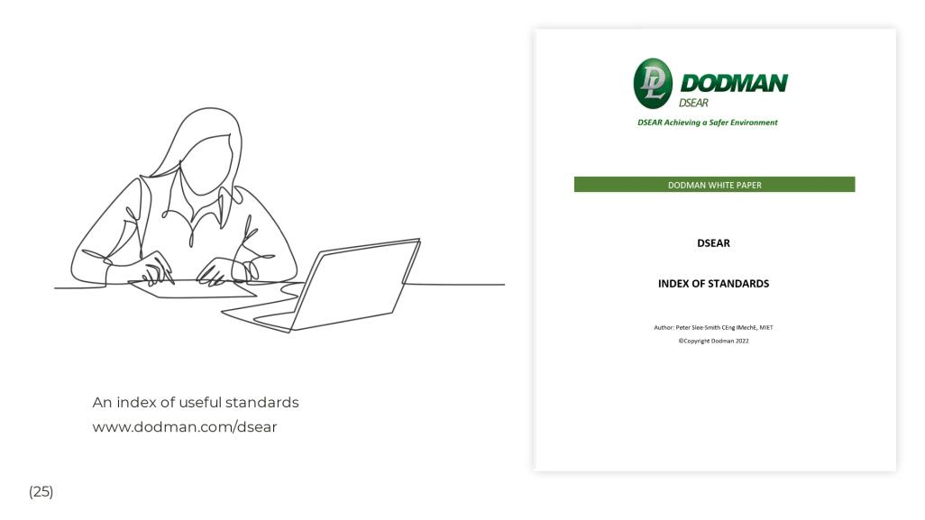
Notes:
(25) Jo finds that more than a hundred technical standards may be helpful in the design of the equipment she needs to upgrade. She needs to source specialist equipment, and she will need certified proof of its compliance.

Slide 35
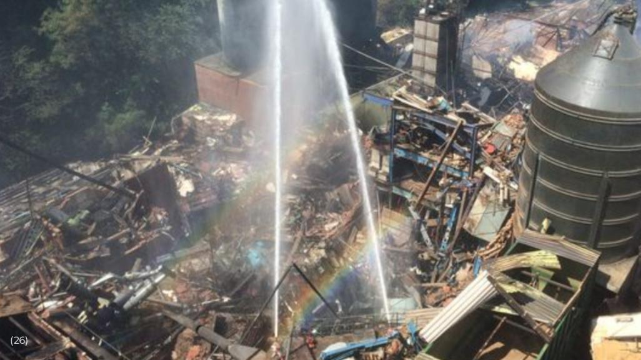
Notes:
(26) In every good story, there is a villain, and this story is no different. The true villain is the fire or dust explosion, which may wreak havoc on the company. A fire or dust explosion can flatten a factory, killing the workers and bankrupting the company. There have been numerous cases of such incidents. In all cases, the Companies involved explain that it has never happened to them before. Companies that suffer a severe dust explosion don't get a second chance.

Slide 36
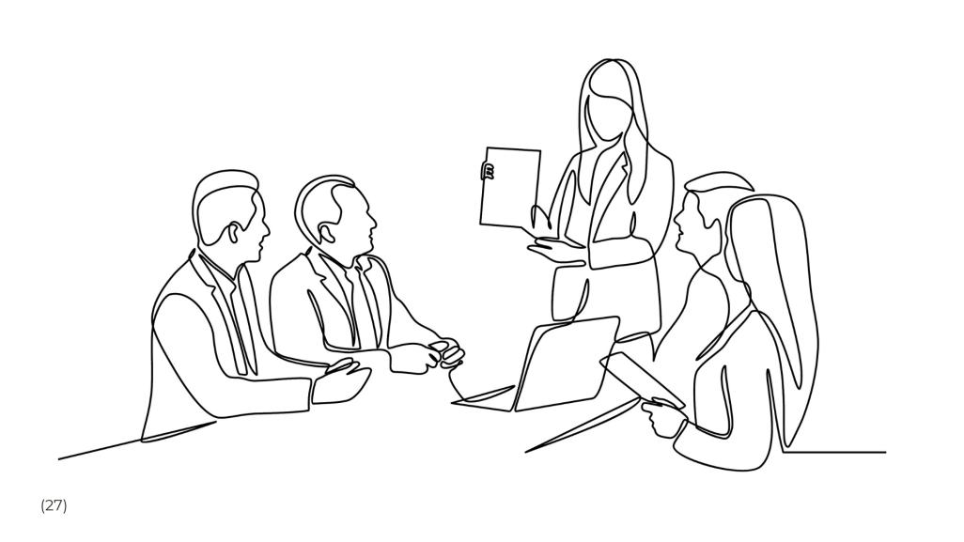
Notes:
(27) However, there are antagonists too. These people have other responsibilities that may frustrate the implementation of DSEAR compliance. Colleagues responsible for Production see the implementation of DSEAR as an interruption to output, or colleagues in Finance who see DSEAR implementation as an unaffordable cost. Some suppliers wish to sell equipment regardless of the risk assessment requirement. Factories are full of equipment that is ATEX certified but unsuitable to address the DSEAR risk. Management can be responsible for lacking the understanding and complexity that DSEAR provides. Often factories are full of equipment that predates DSEAR. Often, poor system selections made over previous years render equipment unsuitable. Attempting to resolve DSEAR problems across a manufacturing site is usually a significant investment in time and money and requires very high-level support.

Slide 37
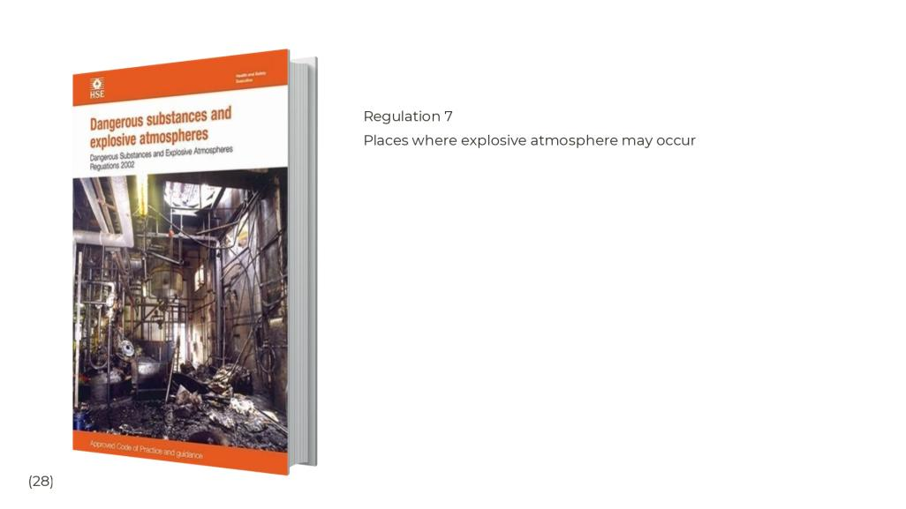
Notes:
(28) Jo learns that regulation 7 requires the classification of hazardous areas into Zones.

Slide 38
Notes:
(29) Places where an atmosphere of gas, vapours or mists are classified into Zones of Zone 0 where continuous or for long periods. Zone 1 for areas where the gas is likely to occur, and Zone 2 for areas where the gas may be present for short periods.

Slide 39
Notes:
(30) Similarly for hazardous dust, Zone 20 is allocated for areas where the dust is continuous or for lengthy periods, Zone 21 for areas where the dust occasionally occurs and Zone 22 where it is present for short periods only.

Slide 40
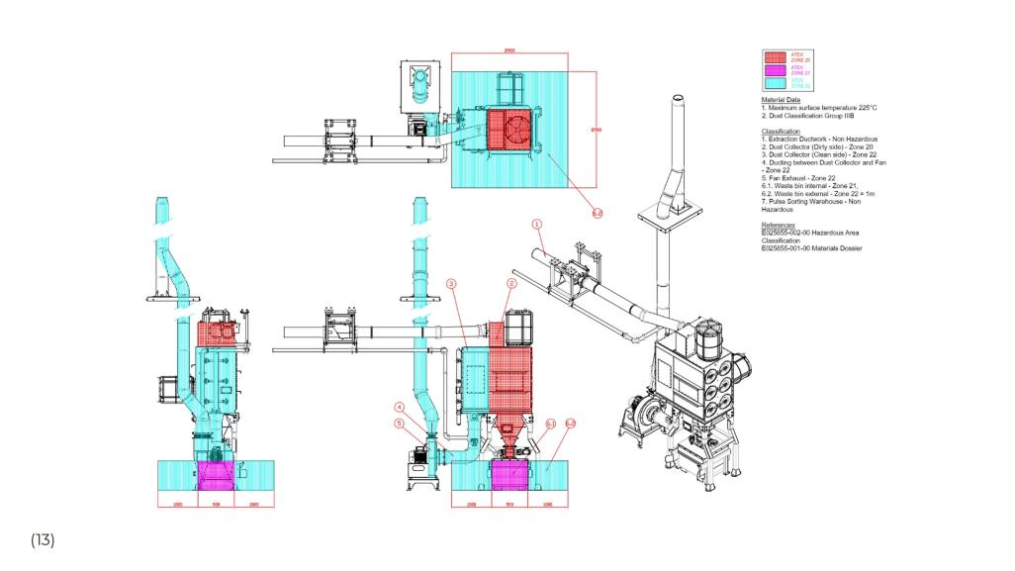
Notes:
(31) These areas are shown in a hazardous area classification drawing

Slide 41
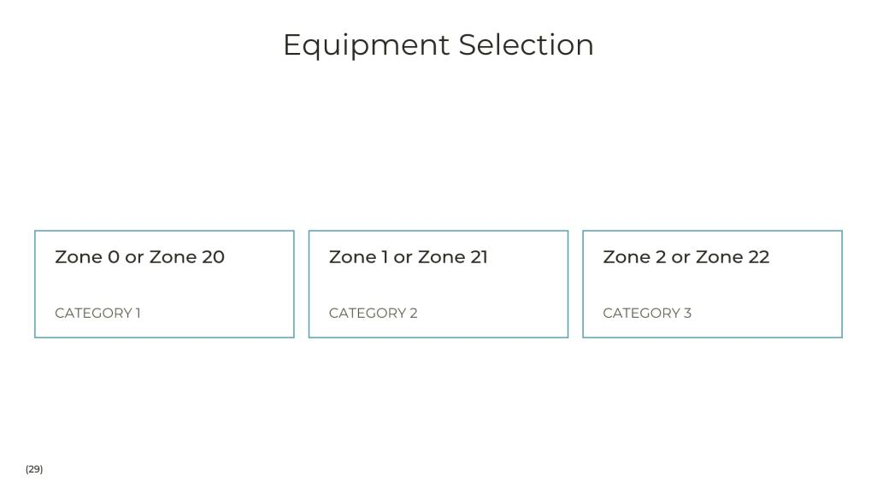
Notes:
(32) Jo learns that these Zones are then used to ensure the correct equipment is selected.

Slide 42
Notes:
(33) DSEAR requires that documented plans are established to deal with accidents, incidents and emergencies. These plans will include predictions for the scale or magnitude of possible incidents. Where these are considered too great, the risk assessment and mitigation processes carried out in Regulation 5 and 6 will be repeated to reduce the risk further. Jo understands that the company will be responsible for documenting plans for communications, evacuation, warnings and places of safety.

Slide 43
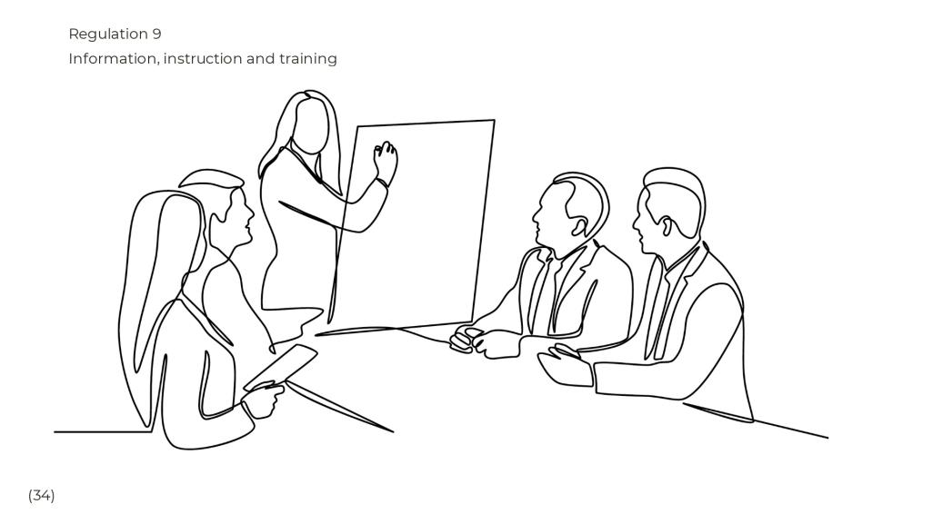
Notes:
(34) Jo will need to ensure that the company provides information and training to ensure all staff are prepared for the emergency procedures identified in Regulation 8. If any work processes change, it will be necessary to update the information and training.

Slide 44
Notes:
(35) Jo is pleased to learn that Regulation 10 is the last of the regulations which require her attention. This regulation requires that pipes and containers are correctly identified.

Slide 45
Notes:
(36) Jo has learnt a great deal about DSEAR in the past few weeks. Jo has learnt that DSEAR places significant responsibility on the Employer. Jo realises that to tackle the long list of recommendations identified in the audit; she will need help. On the internet, she finds many valuable sources of information. The HSE offers guidance and papers on the risk of fire and explosion, some of this information is explicitly aimed at the food industry. The Solids Handling and Processing Association (SHAPA) offers further guidance, and the Dust Safety Science website provides helpful information too. The Dodman White Paper helps to summarise the responsibilities of DSEAR to her colleagues and lists many valuable resources.

Slide 46
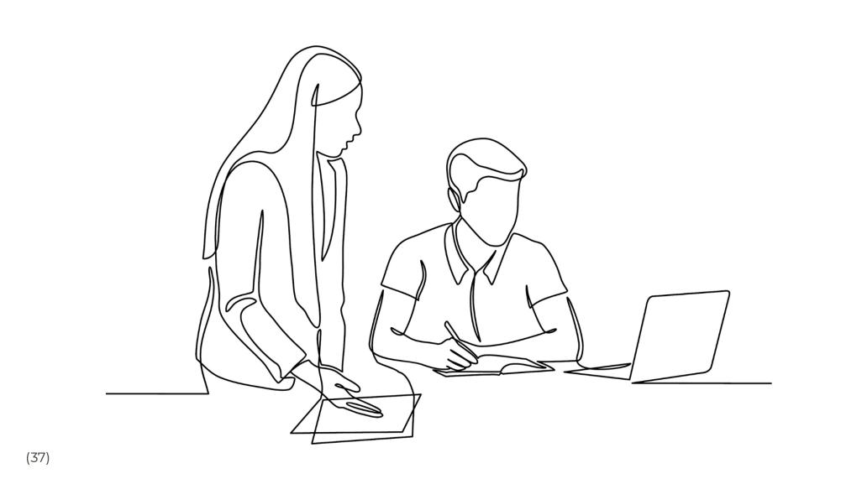
Notes:
(37) Jo feels that despite learning a lot, she is not yet an expert in DSEAR. Jo considers where she may receive help to implement and share the responsibility for DSEAR compliance. The DSEAR auditors are a useful contact and will help explain the requirements. Consultants specialising in DSEAR offer a wide range of services. Suppliers can provide valuable information regarding fire and explosion protection. Jo also finds a company that will provide support through all stages of the risk assessment, design and implementation phases, ensuring DSEAR compliance is achieved.

Slide 47
Notes:
(38) It was now possible for Jo to provide a structured plan for the outstanding DSEAR tasks. The results of DSEAR implementation would not be as quick as management had hoped, and the work would take several years, but there was now a plan.

Slide 48
Notes:
Thank you for listening to this story of DSEAR implementation DSEAR can be complex and me and my team would be pleased to help if we can You can contact me using the details on the screen I took a few risks preparing this presentation as a story rather than a technical set of slides The accompanying notes include a summary of DSEAR, and a list of technical standards which may be a useful reference I would welcome feedback as to whether this approach was successful Thank you

Slide 49
ATEX
We don’t know What We don’t Know

Slide 50
My History
Aims
How can we guarantee Hazardous Area equipment is safe?
What are the relevant standards for product assessments for non-electrical equipment to ATEX
What is technical compliance?
Examples of issues with ATEX
23 years
Who is taking care of them now?!

Slide 52
Hazardous Area
3 Schemes
ATEX
UKEX
IECEx

Slide 53
ATEX has been a mandatory legal requirement within the EU since 2003.
The directive is to protect employees from explosion risk in areas with a potentially explosive atmosphere.

Slide 54
Ignition Prevention
The aim is to manage any ignition source
Electrical Equipment, Non-electrical Equipment
How is this done?
Electrical Equipment
Testing
Non-Electrical Equipment
Risk Assessment

Slide 55
The aim is to manage any ignition source
What is the risk & how do we control it?
Identification of ignition hazards
Determine protective measure
Estimate how often it might happen
Decide on your protective measures to reduce or eliminate likelihood of ignition
Then check your measures
Use technical standards
ATEX allows manufacturers to self-certify mechanical equipment for Zone 1 & Zone 2
No review of the risk assessment and/or technical file
No testing
OEM and End Users are responsible for ensuring compliance to the ATEX Directive.
Reliance on a Declaration of Conformity
How can we guarantee Hazardous Area equipment is Safe?

Slide 56
What are the relevant standards for product assessments for non-electrical equipment to ATEX?
IEC/ISO 80079-36
Explosive atmospheres — Part 36: Non-electrical equipment for explosive atmospheres — Basic method and requirements
IEC/ISO 80079-37
Explosive atmospheres — Part 37: Non-electrical equipment for explosive atmospheres — Non-electrical type of protection constructional safety ''c'', control of ignition sources ''b'', liquid immersion ''k‘’
IEC/ISO 80079-38
Explosive atmospheres — Part 38: Equipment and components in explosive atmospheres in underground mines
Design, Construction, Testing, Marking,
Risk assessment process, Determine our equipment protection level.
we can then apply measures to prevent the ignition source from becoming effective
Protection concepts,
Constructional
Control of ignition sources
Liquid immersion

Slide 57
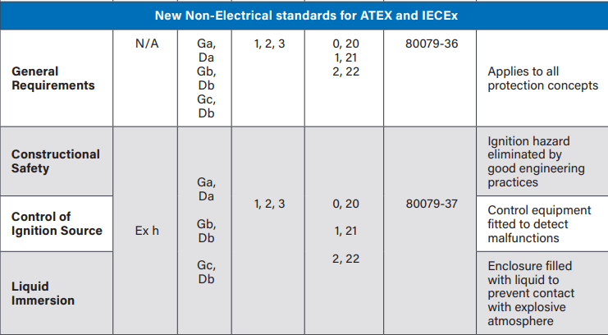
These standards must apply to ATEX products suppled since October 2019

Slide 58
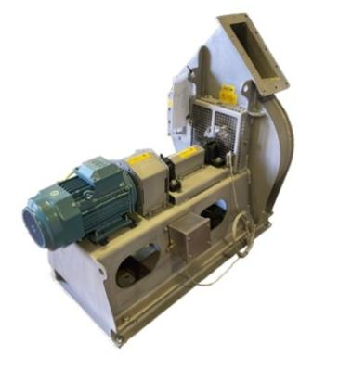
Additional standards
Additional standards
EN 1834 internal combustion engines
EN 1755 Industrial Trucks
Fans are listed as safety critical
EN14986:2017 Design of fans working in a potentially explosive atmospheres

Slide 59
We don’t know what we don’t Know
11. Responsibilities of manufacturers: conformity assessment
Conformity assessment according to the conformity assessment procedures applicable to the product, is the responsibility of the manufacturer only, whether the Directive provides for the involvement of a notified conformity assessment body, or not.
“All manufacturers should know what standards are applicable, because they are placing the products on the market.”
“It is the manufacturers responsibility to find out what standards their products should be assessed to”

Slide 60
EN14986:2017
Design of fans working in potentially explosive atmospheres
Safe
EN80079-36:2016
Explosive atmospheres. Non-electrical equipment for explosive atmospheres. Basic method and requirements
EN80079-37:2016
Explosive atmospheres. Non-electrical equipment for explosive atmospheres. Non-electrical type of protection constructional safety ''c'', control of ignition sources ''b'', liquid immersion ''k''

Slide 61
24% of corporate losses is due to fire incidents and explosions.
Everyday, there are 16 industrial explosions!

Slide 62
recap

Slide 63
“The end user is not an economic operator”
“Manufacturers of the product & whole systems are the economic operator”
“Responsibility for compliance of the equipment as supplied would be on the equipment manufacturers”
The manufacturer of the whole system/equipment must ensure each part they purchase is compliant
All Parties must undertake their due diligence

Slide 64
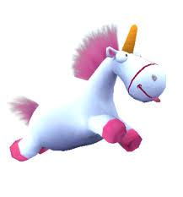
What Is Technical Compliance?
Where can I get help?
I want to believe I am asking the experts.
I want to believe what I purchase is certified
Giving advice since 1985
It is your responsibility to ensure your operations are safe
Extensive expertise
This company did not know the requirements of non-electrical ATEX equipment

Slide 65
Where can I get help?
94/9/EC not 2014/34/EU
Cost of the course £500.00
This company did not know ATEX covered non-electrical equipment

Slide 66
Example of a quote caveat
“We are unable to accept liability for the design and specification of the product in its intended application”

Slide 67
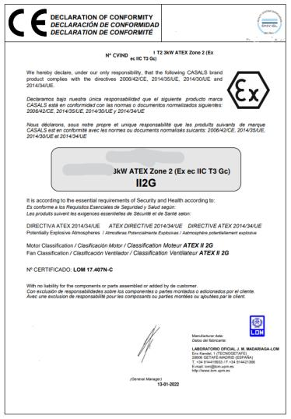
What is technical compliance?
Example of Self certified ATEX fan
Fan is delivered with declaration of conformity
Incorrect directive 2014/35/EU?
Certificate number lists lodged technical file?
Has incorrect equipment protection level
Unreviewed technical file
No Applied National & Harmonized Standards that the product meets the ATEX Directive?
No distinction between internal & external zones
Is this really an ATEX fan

Slide 68
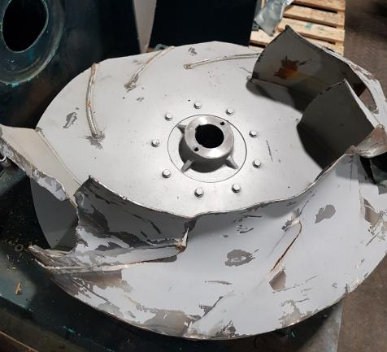
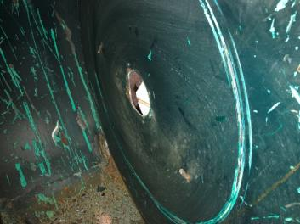
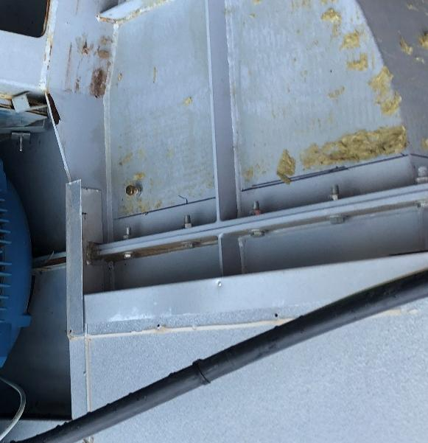
Example Of Self Certified ATEX Fan
Fan has a lodged technical file
90kW ATEX Fan rotating at 1450rpm…
Same power as a family car traveling at 70mph on the motorway!
Unreviewed technical file

Slide 69
340 million industrial accidents…
380,500 Industrial fatalities per year..
95% of accidents are mechanical failures.

Slide 70
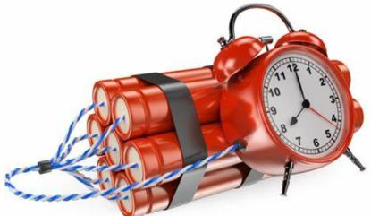
Are We Sitting On A Time Bomb
Self-certification or a lodged technical file
I don’t expect the fan to spark or fail

Slide 71
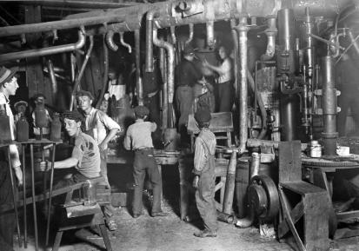
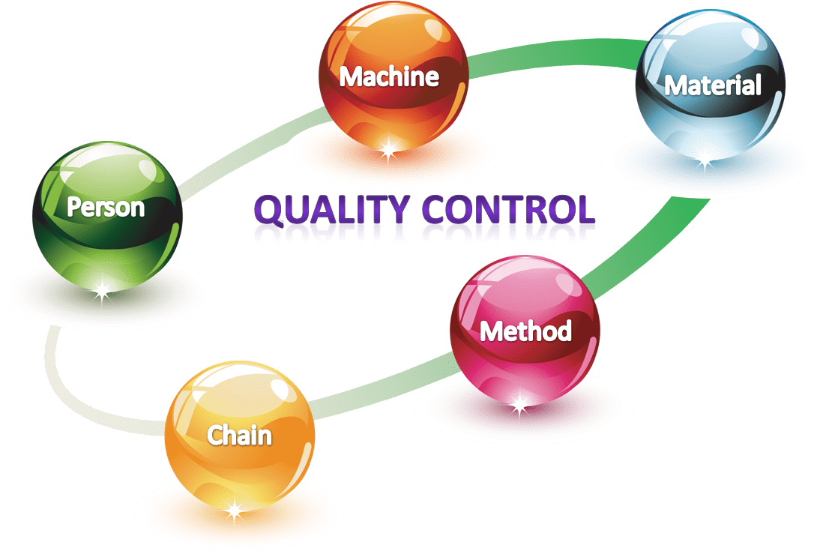
ATEX
What is technical compliance?
Who are manufacturing the ATEX products?
What levels of controls are in place?
What level of technical expertise is available at the manufacturer?

Slide 72
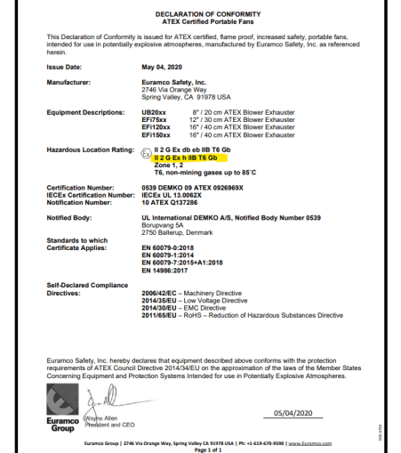
Example of
Declaration of conformity
EN14986:2017
No reference to
IEC/ISO 80079-36
IEC/ISO 80079-37
To label Exh it must be assessed to 80079-37

Slide 73
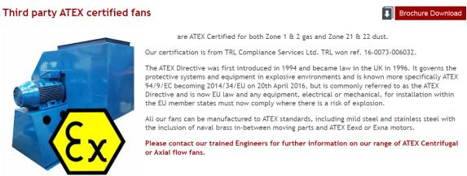
Example of misleading information from manufacturers
Not 3rd Party Certified!
No type examination certificate by a Notified body!
Our certification is from TRL Compliance Service Ltd Ref 16-0073-006032
NB Year ATEX certificate number
Sira 09 ATEX 1234x

Slide 74
Dust Collector
Fully experienced in the requirements of the ATEX directives and can supply products which ensure you are ATEX compliant
offers safe and reliable solutions for handling combustible dust and gases. Based on the customer’s risk evaluation, we recommend suitable equipment for each application. The products are designed to comply with the ATEX directives.
Heavy-duty carbon steel construction and thermal cured powder coatings provide unparalleled strength and durability. collectors exceed OSHA mandates for factory air quality, and when equipped with a explosion vent, they offer the highest combustible dust explosion protection in accordance with NFPA and ATEX standards.

Slide 75
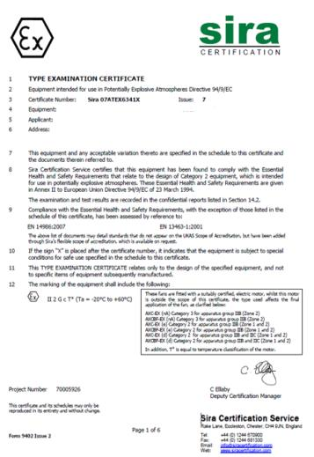
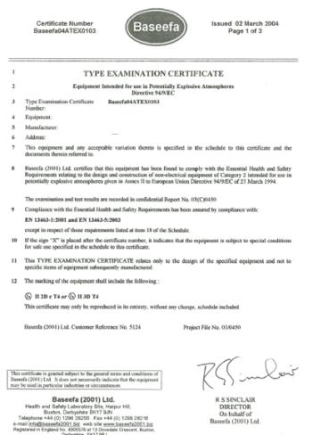
Independently certified
Directive 94/9/EC, EN14986:2007
EN 13463-1:2001, EN 13463-5:2001

Slide 76
Outdated standards on declaration of conformity
EN 13463-1:2001
Non-electrical equipment for use in a potentially explosive atmospheres. Basic method & requirements
EN 13463-5:2003
Non-electrical equipment for use in a potentially explosive atmospheres. Protection by constructional safety ‘c
Superseded or Withdrawn
It is important to note that as of October 31, 2019, the EN 13463-series of standards for non-electrical equipment no longer provide conformity to the ATEX Directive.

Slide 77
How can we guarantee Hazardous area equipment is Safe?
ATEX Manufacturers need to use the current EU harmonised standards to demonstrate that products, services, or processes comply with relevant EU legislation.
UKEX, in the UK we now have designated standards to show compliance
Technical files for ATEX products must be lodged with an EU Notified body
Technical files for UKEX products must be lodged with a UK Approved Body.

Slide 78
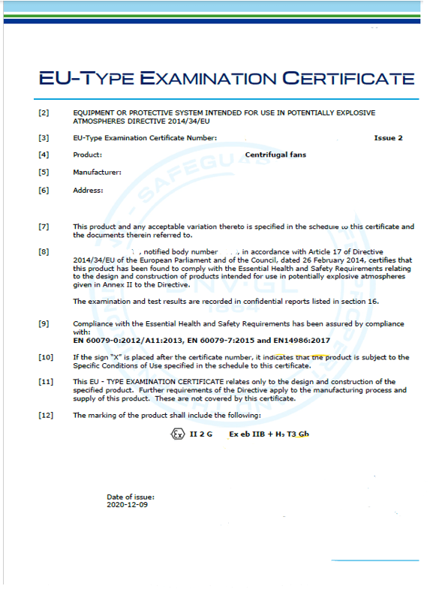
Notified bodies
They don’t know what they don’t know
Issued in 2020
EN80079 standards
Mechanical equipment marking incorrect!
Let’s ask the NB

Slide 79
Notified bodies
They don’t know what they don’t know
How can the mechanical standard for fans be assessed electrically?
NB are commercial organisations.
They will only do what you ask them to do

Slide 80
In the last 2 years we have had an 8% increase in deaths in hazardous areas

Slide 81
The ‘Blue Guide’ on the implementation of EU products rules 2016
(2016/C 272/01)
What is a manufacturer's declaration of conformity?
The EU declaration of conformity (EU DoC) is a document in which the manufacturer, or his authorised representative within the European Economic Area (EEA), indicates that the product meets all the necessary requirements of the Union harmonisation legislation applicable to the specific product. The EU DoC shall also contain the name and address of the manufacturer along with information about the product, such as the brand and serial number. The EU DoC must be signed by an individual working for the manufacturer or his authorised representative, and the employee's function shall also be indicated.
Indicates that the product meets all the necessary requirements of the Union harmonisation legislation applicable to the specific product
Whether a Notified Body has been involved or not, the manufacturer must draw up and sign the declaration of conformity.
“It is the manufacturers responsibility to find out what standards their products should be assessed to”

Slide 82
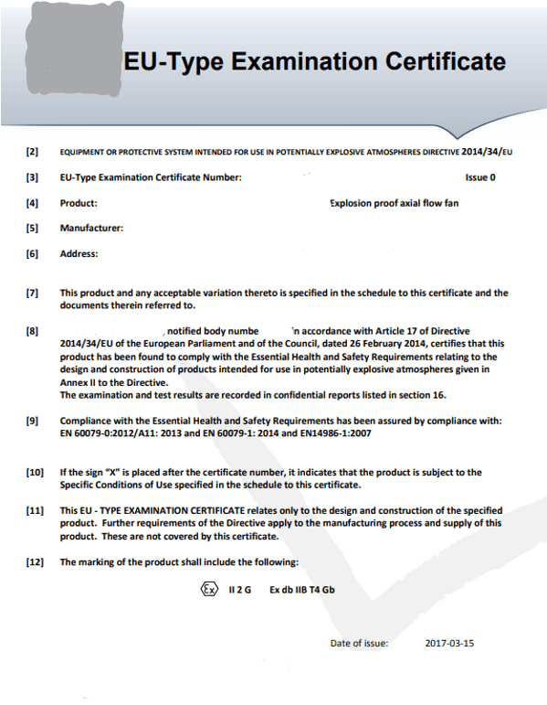
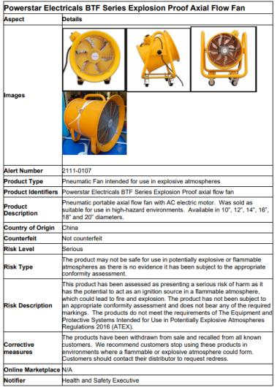
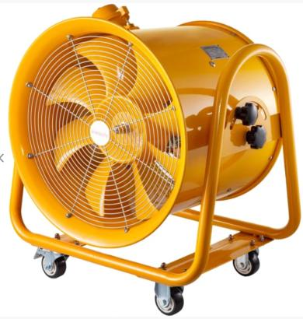
Unsafe “explosion proof” fan recalled after being found to be an ignition risk
The distributor is currently recalling 1000 units

Slide 83
In summary
How can we guarantee Hazardous area equipment is Safe?
No mention of the relevant mechanical standard
Referencing electrical standard only
Referencing outdated standards
Mechanical failing of the product to the standards
No assessment of all the relevant documents
If you miss something it’s your fault
Self-certification or a lodged technical file
If you mark your own exam
You Will Always Pass

Slide 84
We don’t know what we don’t know
Who is looking after them now?
How do we all work to the safest solution?
How do we keep future industry safe?
Can we agree on the correct way to work!
Final Question
Has your company done the best it could to keep people safe?

Slide 85
We don’t know What We don’t Know
Any Questions

Slide 86
Thank you!
WEBINAR CLOSE
Lydia Barber – Filtermist UK (Lydia.Barber@filtermist.com)
David Frise [CEO] and Charlie Pierpoint – the BESA

